Slide 1


Breaking Down Your
Website Quality Assessment
PREPARED FOR
Peak 1
May 2025

Slide 2


What’s in this document?
1
What “website quality” is and why it’s important.
2
What inputs go into the report and how we analyze them.
The outputs of the report and how we use them to execute your campaign.
3

Slide 3
What is “Website Quality”?
Search engines send traffic to websites they deem as “high quality”. That means a few things:
Sites that are coded and structured according to their webmaster guidelines.
Sites that are “popular”, i.e. getting mentioned across the web.
Sites that satisfy “searcher intent” through relevant and quality content.
Having low quality pages, content, poor structure and lack of web mentions causes Google to lose trust in your website and crawl, index and rank it less and less over time.
We assess quality of your website by looking at a number of different data inputs, including inbound links, titles, content depth, sales from organic traffic, keyword rankings and more.
Additional resources:
Google’s Quality Score (Moz)

Slide 4

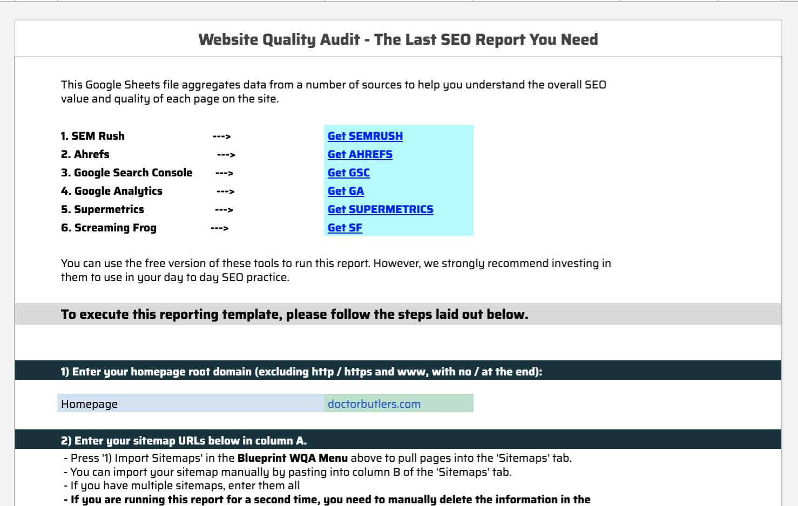
What goes into the “WQA”?
Our team built a tool using API data from 5 vital SEO data sources:
XML sitemaps - to get a list of URLs included in your Sitemap.
Screaming Frog - to get a full list of URLs and files uploaded to your site, page titles, metas, canonical tags and word count per page.
Ahrefs (Backlinks) - to get a list of the links pointing to your website and which pages they point to.
Ahrefs (Keywords) - to get your current keyword rankings and which pages they correlate to.
Google Analytics - to get sales, leads, and traffic data from search engines only.
Google Search Console - to get SERP impressions and page level click through rates in Google.
Our tool aggregates this data and allows us to assess quality metrics at the page level. From here, we can make a decision about what to do with every page on your site.

Slide 5

Transportation Company
What comes out of the “WQA” - Site Sections
Category Tag | Detail
Home Page | Landing page highlighting fleet options, popular charter routes, and booking inquiries.
Transportation by Destination | Individual pages detailing each charter service to or from a specific location.
Transportation by Vehicle Type | Dedicated pages for each specific vessel or vehicle in the fleet.
Destination Pickup/Drop-off Information | Detailed pages for charter routes, itineraries, or popular destinations.
Destination Travel Guide | Informational pages about destinations accessible via charters.
Pricing & Packages Page | Pages clearly outlining pricing structures and charter packages.
Traveler Testimonials/Reviews | Pages displaying reviews and customer feedback.
Safety Information Page | Informational content covering safety protocols and certifications.
Blog Post | Individual articles sharing charter tips, destination highlights, or company news.
Blog Category | Categories for organizing blog posts into clear topics.
Resource / Guide | Standalone content guides providing FAQs, booking tips, and travel recommendations.
Site Info | Essential information (privacy policy, terms of service, contact).
Author Page | Profiles for authors or contributors to the site.
Gallery Page | Visual content showcasing the fleet, destinations, or charter experiences.
After the data is pulled and aggregated, the manual process begins. The first thing we do is group each page into a “section” (see chart for all the section categories we use). We do this for two reasons:
It allows us to segment the site and better prioritize pages / keywords to focus on.
It allows us to compare “apples to apples” (i.e. we don’t want to be comparing an FAQ page to a product page).

Slide 6
What comes out of the “WQA” - URL Actions
URL Action | Detail
1. Leave As Is | No action needed on the page. You can use this tag for pages performing well or for pages you simply want to ignore because they are irrelevant to your SEO (contact page, etc).
2. Update "On Page" | Use this when you want to review the keywords, titles, meta and on page content for that URL. This can also be used for evergreen, cornerstone blog posts / resource guides that you want to update with more recent information. URLs assigned this URL Action are moved into the “KW Research for Existing Pages & On-Page recommendations” deliverable.
3. Target w/ Links | If everything checks out with the page but it doesn’t have rankings, the best solution is to target it with links. You can also double up to “Update On Page” and “Target w/ Links” using both action columns.
4. 301 (Redirect) | When a page serves no value to the website (both for search engines and users) you will want to 301 redirect it into a more relevant page.
5. Canonicalize | If you have similar pages targeting the same topic but you NEED both pages (i.e. you don’t want to remove the page), set a canonical tag that points to the page you want to rank.
6. Block Crawl | If you have a group of pages that serve NO value to search engines (but have value to website visitors), the best option is to block that section from being crawled. This works best when pages are grouped by URL structure (i.e. /archives/).
7. No Index | If you want to stop Google from indexing a low quality page, use this tag. Blocking Crawl is reserved for a number of pages or site sections, No Index is reserved for individual or stand alone pages.
8. Content Analysis | For content (blogs or resources) where there is potential value in updating & optimizing the content for search. URLs assigned this URL Action are moved into the “Content Analysis” deliverable.
9. 410 Delete | If a page no longer serves a purpose to the website, has NO links, NO traffic and the keywords are no longer relevant, we can delete it.
10. Find and Replace URL | If a “301” page is discovered during the crawl, and the internal link can be replaced with its “Final URL” to remove an extra step for crawlers to move through, we want to find that URL and replace it with its final location.
11. Find and Remove URL | If a “404” page is discovered and there is no suitable replacement for the page, we want to find where the broken link is located and remove the link from the site.
After each page on the site is classified into a category, we can quickly assess each page for quality (by section). We assign each page a “URL Action” (see chart to the right for full list and explanations of each). These “URL Actions” dictate:
Which pages to clean up (i.e. redirect, NOINDEX, etc)
Which pages have no potential for traffic and to ignore (i.e. contact page)
Which pages we will focus on for the campaign (i.e. perform KW research, update “on page” elements, target with links).

Slide 7
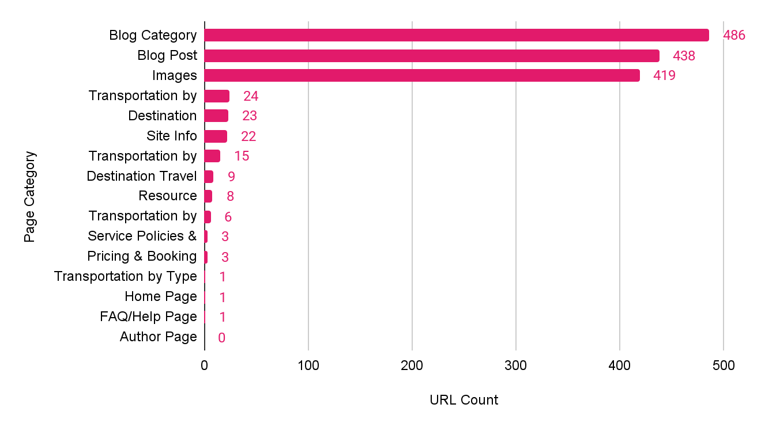
Site Structure Overview
Site Structure
Blog Category pages and Blog Post pages make up the bulk of the website - almost 1,000 pages total.
Together, this is more than almost all of the other pages on the site combined.
Notes:
Link to Chart: https://docs.google.com/spreadsheets/d/1xLy7Mtc2lnKykzUKfIG6-6c5MaC2EtfkDH_kfk5GecE/edit?gid=1618588231#gid=1618588231

Slide 8
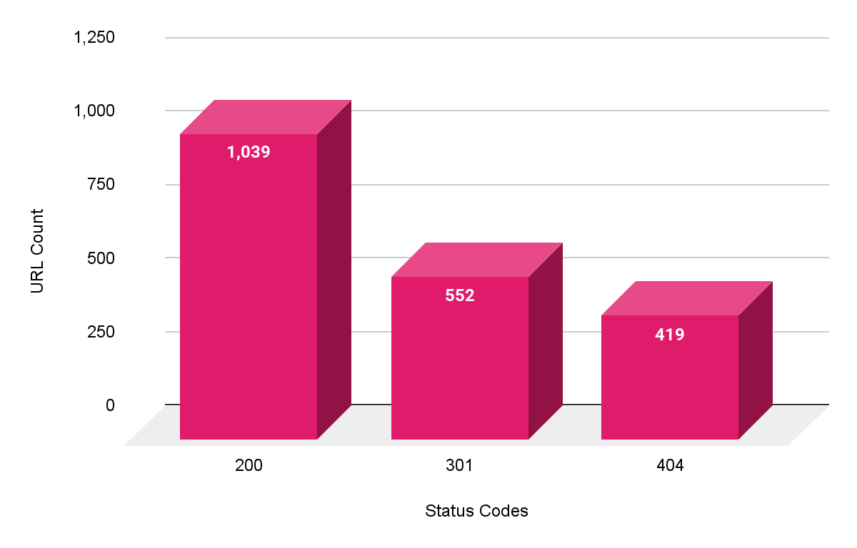
Site Structure Overview
Status Codes by Category
There are a large portion of links across the site that need to be fixed or removed entirely.
In total, there are close to 1,000 URLs that are either 301 Redirects or 404 pages, which means a large amount of authority is being sent through a redirect chain, or to a broken page.
Notes:
Link to Chart: https://docs.google.com/spreadsheets/d/1xLy7Mtc2lnKykzUKfIG6-6c5MaC2EtfkDH_kfk5GecE/edit?gid=1975750220#gid=1975750220

Slide 9
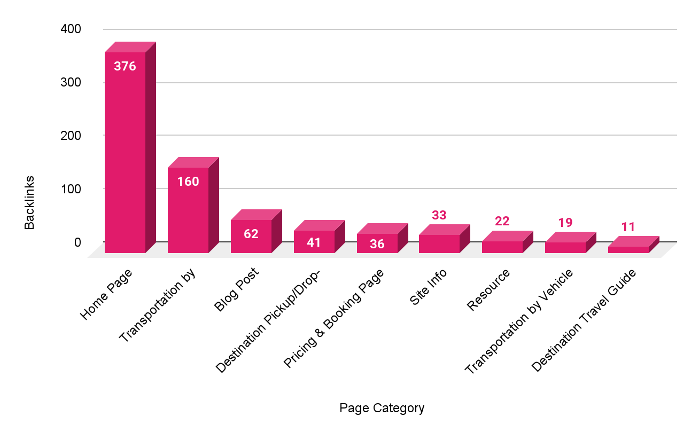
Site Authority Overview
Backlinks by Category
Bulk of dofollow backlinks pointing to the site are currently going to the Home Page
Transportation by Destination pages have the second highest amount of backlinks compared to other site sections - this is a strong sign, as these are the most important pages to build links to
Notes:
Link to Chart: https://docs.google.com/spreadsheets/d/1CNChHS8-gO7lqbSYQlH-LxSfJwzyimmYhFJGy6CzZ-g/edit?gid=1307378891#gid=1307378891

Slide 10
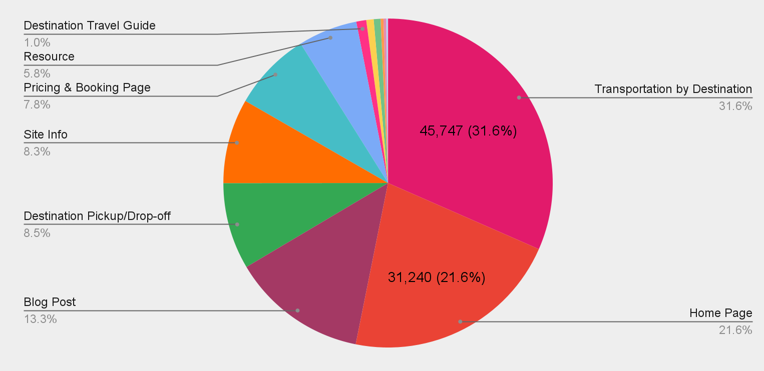
Organic Performance - Traffic
Sessions by Category
Notes:
Link to Chart: https://docs.google.com/spreadsheets/d/1xLy7Mtc2lnKykzUKfIG6-6c5MaC2EtfkDH_kfk5GecE/edit?gid=92554350#gid=92554350

Slide 11
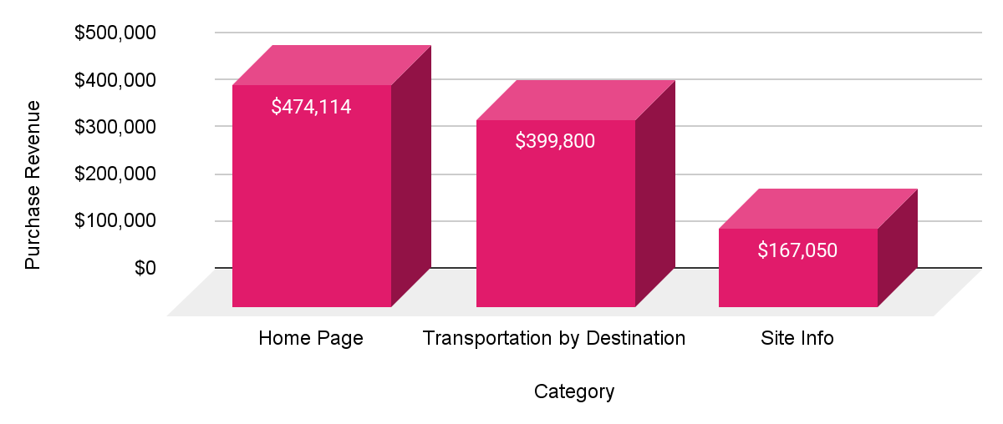
Organic Performance - Bookings
Pages & Site Sections Driving Organic Revenue
At this time, the Home Page is the leading landing page driving the most revenue from users who arrived from organic search.
Following the home page, Destination specific shuttle transportation pages are driving organic revenue, with the Breckenridge and Vail pages leading the pack.
Top 5 Pages by Revenue | Purchase Revenue
https://www.mountainshuttle.com/ | $474,114
https://www.mountainshuttle.com/book-now/ | $161,413
https://www.mountainshuttle.com/shuttle-destinations/breckenridge/ | $116,447
https://www.mountainshuttle.com/shuttle-destinations/vail/ | $90,216
https://www.mountainshuttle.com/shuttle-schedules/ | $76,425
Notes:
Link to Revenue by Category Bar Chart: https://docs.google.com/spreadsheets/d/1CNChHS8-gO7lqbSYQlH-LxSfJwzyimmYhFJGy6CzZ-g/edit?gid=1065132173#gid=1065132173
Link to Top 5 Pages by Revenue Table: https://docs.google.com/spreadsheets/d/1CNChHS8-gO7lqbSYQlH-LxSfJwzyimmYhFJGy6CzZ-g/edit?gid=1611787336#gid=1611787336

Slide 12
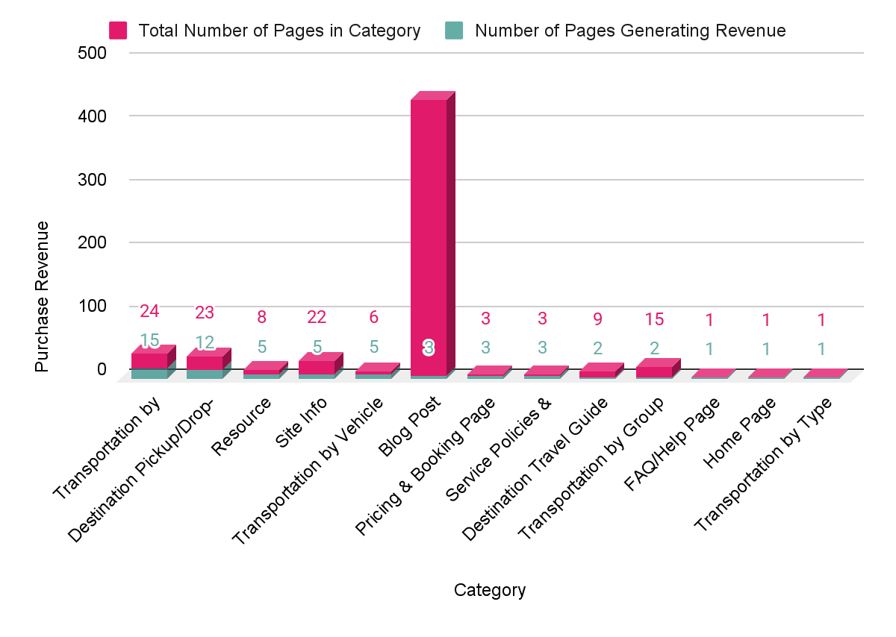
Organic Performance - Bookings
Number of Pages Driving Revenue by Section
Notes:
Link to # of Pages Driving Revenue by Category Bar Chart: https://docs.google.com/spreadsheets/d/1CNChHS8-gO7lqbSYQlH-LxSfJwzyimmYhFJGy6CzZ-g/edit?gid=1428278599#gid=1428278599

Slide 13

What are your outcomes?
Issue: Internal Links Point to 301 Redirects
Over 500 internal links on the site point to URLs that return a 301 redirect instead of linking directly to the final destination page.
Why This is a Problem:
Wasted Crawl Budget: Search engines must crawl both the redirect and the destination, reducing efficiency.
Diluted Link Equity: Although Google passes PageRank through redirects, some value may be lost or delayed.
Slower Page Load: Each redirect adds extra HTTP requests, which can negatively affect page speed and user experience.
Signals Confusion: It creates unnecessary complexity for search engines trying to interpret your internal structure.
Recommendation: Update all internal links to point directly to the final URL
Using the “Find and Remove or Replace” tab in the WQA, perform a Find and Replace for all 301 Redirects on the site, as instructed by the sheet. This will fix all issues in the “Aggregation” tab assigned a “Find and Replace” URL Action.
IMPORTANT NOTE: For any rows where “Header” or “Footer” appear in Column G “Link Position” of the “Find and Remove or Replace” tab, this means the URL to replace appears in a single location in the menu and footer of every single page. Fixing one of these instances should fix this in every other single instance it appears in that spot.

Slide 14
What are your outcomes?
Issue: Pages or Links Returning 404 Errors
Over 500 internal links - or previously indexed pages and images - return 404 (Not Found) errors, meaning the content is missing or the page has been removed without a redirect.
Why This is a Problem:
Poor User Experience: Users hitting dead ends can become frustrated and leave the site, reducing engagement and trust.
Wasted Crawl Budget: Search engines waste time crawling broken pages instead of valuable content.
Lost Link Equity: If other internal or external pages link to a 404 URL, that authority is lost unless it’s redirected appropriately.
Negative SEO Signals: A large number of 404s can be interpreted as poor site maintenance or content decay.
Recommendation: Update all internal links to point directly to the 404 URL
Using the “Find and Remove Images” tab in the WQA, locate the “Find and Remove” instructions in Column A to locate all the URLs that should be removed.
This will fix all issues in the “Aggregation” tab assigned a “Find and Remove” URL Action.

Slide 15

THANK YOU!
www.propellic.com

